Slide 1
Welcome to…
(virtual)
Graduation Info Night!
We will begin at 5:00. Thanks for joining us!
Notes:
Welcome!
3rd year as grad. Coach / 9 years as teacher
Schedule: Graduation info --> question time --> ACT info --> Title 1
Type questions in the chat box.
Transition to online was easier for us

Slide 2
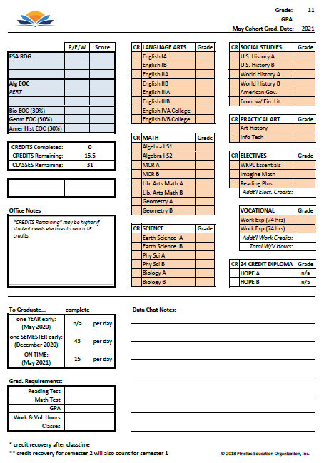
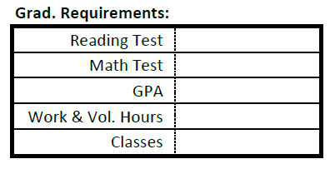
Q: 1
What are the requirements for graduation?
Notes:
Some students overlook the importance of passing the tests
ACT math and reading (October 6-16)
FSA & Algebra EOC (After ACT)
SAT - Spring
PERT - flexible
Work hours can count from first day of enrollment
74 hours = half credit
Cash for work is ok
TRANSITION: Deadline to finish everything is app. 2 weeks before graduation (12/3).
18 v. 24 credit diploma

Slide 3
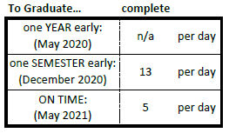
Q: 2
How long will it take for my student to graduate?
Notes:
Shortened Apex classes due to covid
Attendance
not “will they pass” but “how quickly will they pass”?
Time to complete a class is a better indicator of being on track than the grade in a class.
Students can work from home and on the weekends
GoToMeeting rooms
SHOW: WEEKLY PROGRESS REPORT EMAILS

Slide 4
Q: 3
What are some common obstacles to graduation?
Personal situations
health
childcare
transportation
Demanding jobs
Fear of the unknown
Notes:
Personal situations:
depression, anxiety - p/t psychologist / Bus passes (free)
Work:
Good, but…
Letters to employers
Fear of the unknown:
Check in with teacher on progress! (Staff Directory - call, text, or email)
Newsletter

Slide 5
Q: 4
When and where is graduation?
December 17th
Thursday
7:00 pm
Ruth Eckerd
Hall
May
Details TBD
Notes:
216 total graduates last year!
70ish grads expected in December!
Covid details will be coming (4 guests, etc.)
FULL graduation - board members attend
Professional photographer - pictures available online
No graduation costs for students (they keep cap, tassel, diploma cover)

Slide 6
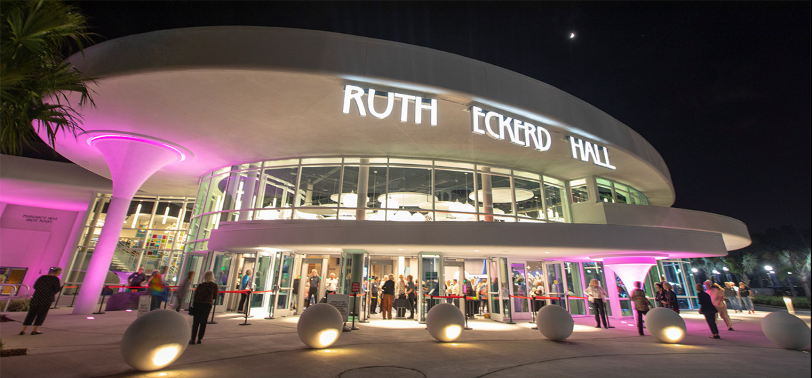

Slide 7
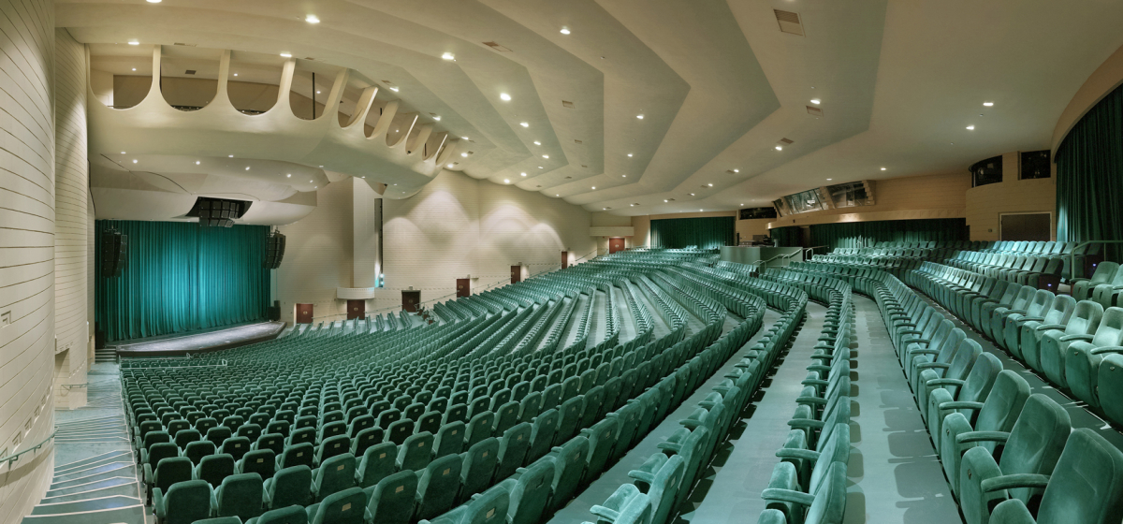

Slide 8
Q: 5
What are the next steps after graduation?
College
Financial Aid
Pinellas Technical College (PTC)
FAFSA
(studentaid.gov)
St. Petersburg College (SPC)
University of South Florida (USF)
Going Merry
Work
Military
Notes:
Important to have a goal!
COLLEGE
USF:
GPA requirement (average was 3.9-4.4)
2 years of a foreign language
SPC:
It’s ok if you don’t know what to study! (first year or so are the same for everyone)
2 yr. / 4 yr. Programs / certificate programs
FUSE program
PTC:
Industry certifications
WORK
Sometimes necessary
Work P/T & College P/T

Slide 9
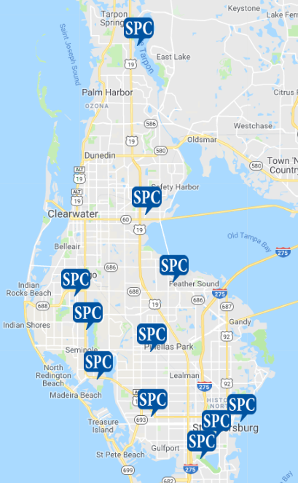
spcollege.edu
Notes:
SHOW WEBSITE (“Request Information” on top right of home page)
Campus tours unavailable for now.

Slide 10
pcsb.org/myptc
Notes:
Clearwater / St. Pete campuses
Industry certifications (8-18 months)
Morning & evening classes
Financial Aid

Slide 11
pcsb.org/myptc
Auto, Marine, or Diesel Technician (14-24 months)
Welding (11-19 months)
Electrician (12 months)
Cosmetology (12 months)
Professional Culinary Arts & Hospitality (12 months)
Practical Nursing (14 months)
Stage Production (3 months)
Notes:
SHOW WEBSITE

Slide 12
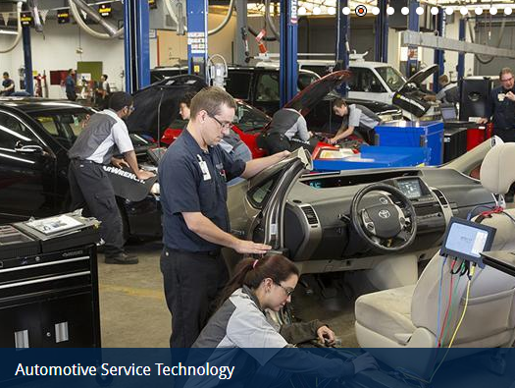

Slide 13
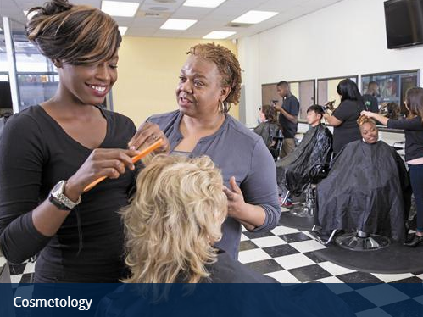

Slide 14
Clearwater campus tours
Michael Gandolfo
gandolfom@pcsb.org
St. Pete campus tours
Chris Blackwell
blackwellc@pcsb.org

Slide 15
David Johnson
Graduation Coach
TEXT: (813) 602-1741
CALL: (727) 474-1237
E-MAIL: David.Johnson@EnterpriseHS.org

Slide 16
Your questions...

