Slide 1
Title I Annual Parent Meeting
September 30, 2024
5:00-6:30 pm
2495 Enterprise Road
Dr. Steven Humphries, Principal
Aaron Jones, Assistant Principal
Donna Hulbert, Business Director
Notes:
Evidence: Upload completed presentation and recorded feedback as part of the evidence to support the Annual Meeting Materials. Do not forget the sign-in sheets, and survey/feedback that you receive throughout the meeting.

Slide 2
Education, then, beyond all other divides of human origin, is a great equalizer of conditions of men.”
– Horace Mann
Notes:
“Education, then, beyond all other divides of human origin, is a great equalizer of conditions of men.” – Horace Mann

Slide 3
All About Title I
Title I is the largest federal assistance program for our nation’s schools.
The program serves 75 schools in Pinellas County including eligible students in 36 non-public schools.
Notes:
Highlight the Title I Program here in Pinellas County.

Slide 4
Title I Funding Process
Pinellas County Schools
Increased Student Achievement
Federal Government
1
3
2
4
Florida Department of Education
Enterprise High School
Notes:
The Florida Department of Education receives funds from the federal government. Districts receive Title I funds from Department of Education, and the school district distributes these funds to schools based on the percentage of children eligible for free/reduced price lunch; however, students do not have to be from low-income families to receive help.

Slide 5
Supplemental Resources
Definition: provided in addition to what is already present or available to complete or enhance it.
https://languages.oup.com/
Notes:
Title I is supplemental federal funding that provides e
Definition: provided in addition to what is already present or available to complete or enhance it extra academic support and learning opportunities for economically disadvantaged students.

Slide 6
Let’s Celebrate!
Enterprise High School earned a “Commendable” School Improvement Rating for 2023-24.
We met 6 out of 6 of our charter goals (100%).
Notes:
Based on the FSA data and school grades, there is a lot to celebrate!!

Slide 7
Title I Programs Provide Supplemental Support
Supplemental Resource | Positive Impact
Additional supplemental personnel: Part-Time Math Teacher | We have more personnel to work with small groups and individual students who need support in math and ELA. This directly impacts student progress in Math and Reading.
Additional training opportunities for school staff | Increased parent engagement
Extended Learning Opportunities | Summer learning schedule
Parent and Family Engagement Resources and Training Workshops | Increased family engagement
Supplemental teaching materials, equipment, and technology | Student growth toward proficiency
Notes:
Use additional slides if necessary. This is where you want to really highlight Title I funding and how it positively impacts your scholars! Additional supplemental personnel (add specific positions)
If there are connections that they can make, they call it out!

Slide 8
Title I Schoolwide Planning and Input
First
Second
Last
Seek Input from school, family, and community members determine how Title I funds are used based on a needs assessment.
Please attend online or in-person meetings/trainings and complete surveys to provide input on Title I funding.
All Title I schools must document that parents are involved in the schoolwide planning process.
Notes:
Evidence for input – input from school can be a survey or notes, which include quotes related to what was shared as feedback AND how this input will be used to inform the PFEP and future engagement activities.
Evidence of Attendance – please include attendance of DIVERSE stakeholder group/s.

Slide 9
Title I Schoolwide Budget
Enterprise High School is provided $35,000 to pay for supplemental resources and programs for increased student achievement.
The large portion of our Title I funds are used form personnel salaries and/or benefits
Part-time , Fully certified Math Teacher

Slide 10
EHS Title I Parent & Family Engagement 2024-25 Budget
Total Allocation - $5,700
Title I Night, refreshments, mailouts, etc.
Family Engagement Resources
We invite you to provide input on the types of activities and trainings you need to support your child’s education.
Notes:
SAMPLE ONLY - Delete Slide
Highlight your budget and resources and how they will be used to support family engagement.

Slide 11
Parent’s Right to Know
As a parent of a student attending a Pinellas County School Public School, you have the right to…
Be
Be provided information on your child’s level of achievement on assessments in Reading/Language Arts, Writing, Mathematics, and Science.
Request and Receive
Request and receive information on the qualifications of your child’s teacher and supplemental personnel working with your child.
Be
Be notified of non-highly qualified or out-of-field teachers at the school.
Be
Be informed if your child is taught by a non-highly qualified teacher for four or more consecutive weeks.

Slide 12
Working Together for Student Success
As a Title I parent you have the right to be involved in the development of the following plans and documents for our school which can be found on our website (enterprisehs.org/resources/title-one) to view as well as in the Parent Station located in the lobby.
School Improvement Plan (SIP)
Title I Schoolwide Plan
Parent and Family Engagement Plan (PFEP)
School-Parent-Student Compact
Notes:
Our school’s Title I Parent Station is located (insert location or photo of Title I Parent Station (front office and on the webpage). Please include photo as part of the evidence monitoring.
You will find a copy of our School Improvement Plan, Title I Schoolwide Plan, School’s PFEP, the School District’s PFEP, Parent’s Right to Know Memo, Upcoming Events, Compact, (insert other documents at your station)

Slide 13
Parent-School-Student Compact
The purpose of the compact is to foster student achievement. By signing the Parent-School-Student Compact, Enterprise High School teachers, staff, parents and students agree to work together to share the responsibility of helping students meet or exceed state, district and school academic goals.
The Parent-School-Student Compact is updated every year to include parent, student, teacher, and staff input. Parent, student, teacher and staff comments are welcome at any time during the year.
Please review and sign your child’s Compact.
Our goal is to receive 100% signed compacts!
Notes:
At the elementary level, school compacts are used as a progress monitoring tool through the year during parent teacher conferences.

Slide 14
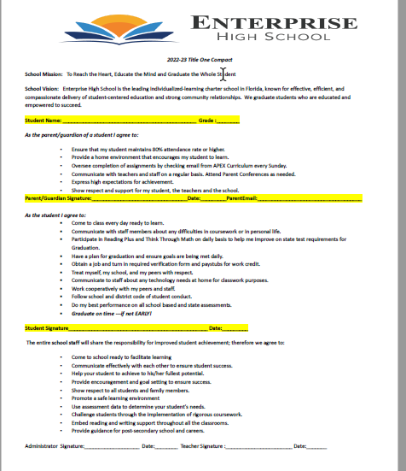
Sample School Compact
Notes:
Highlight any things that unique to your school’s compact.

Slide 15
Parent and Family Engagement Plan (PFEP)
The PFEP Sections include information about the following:
Parent trainings to increase student achievement
Staff trainings for engaging parents
Communication methods between home and school
Flexible meeting times
Accessibility for parents
Coordinating with other Federal Programs
Notes:
Provide information on the specific committees that parents can be involved. Include the purpose, date and time of meetings.
Explain the PFEP and its purpose.
Consider the evidence related Title I Crate, Sample of Evidence,

Slide 16
Parent Advisory Council (PAC)
The District has a Parent and Family Engagement Plan. The summary of the plan is in the Title I School & Family Partnership Overview.
You may access the full plan at www.pcsb.org/titleone
The Parent Advisory Council (PAC) is responsible for reviewing and revising the District PFEP.
PAC will meet virtually or in-person with the district’s Title I staff.
Each school is committed to having at least one member representative on PAC.
PAC meets twice a year, if you are interested in representing our school please notify, Steven Humphries – EHS Principal.
Notes:
Please add your PAC representative in slide and share with your Title I Specialist.

Slide 17
Accountability
School Report Cards
School Grade and Overview
Population and Enrollment
Assessments – Academic Achievement, Growth, and Population
Assessments – English Language Learners
Graduation and Beyond
Educator Qualifications and Equity
Long-Term Goals and Interim Progress
Accelerated Course Enrollment
Per-Pupil Expenditures
National Data
Available online at https://edudata.fldoe.org/ or Front Office

Slide 18
Shift to New B.E.S.T. Standards
Notes:
All curriculum, instruction and assessments are based on student-centered expectations.
FSA 🡪 Transition to BEST!
https://www.flgov.com/2021/09/14/governor-desantis-announces-end-of-the-high-stakes-fsa-testing-to-become-the-first-state-in-the-nation-to-fully-transition-to-progress-monitoring/

Slide 19
Florida Benchmark For Excellent Student Thinking Standards (B.E.S.T). You may read more information by visiting, http://www.fldoe.org/standardsreview/
Notes:
All curriculum, instruction and assessments are based on student-centered expectations.

Slide 20
New Assessment: FAST
More information can be found about the FSA Transition to FAST:
https://feaweb.org/fsa-transition-to-fast/
Source: https://www.flgov.com/2021/09/14/governor-desantis-announces-end-of-the-high-stakes-fsa-testing-to-become-the-first-state-in-the-nation-to-fully-transition-to-progress-monitoring/

Slide 21
Florida End of Course (EOC) Assessments (Algebra 1, Biology, Civics, U.S. History, Geometry)
The Algebra 1, Biology, US History, and Geometry EOC make up 30% of a students’ final grade in those courses. Students are now required to pass Civics Literacy if they want to earn a college degree in Florida. Passing this exam in high school satisfies this requirement.
To learn more about state assessments visit the Florida Department of Education’s website, fldoe.org/accountability/assessments.
Notes:
This slide is only required, if it truly applies.

Slide 22
School’s Curriculum
Florida Benchmark For Excellent Student Thinking Standards (B.E.S.T). form the framework of everything taught at school.
Core Curriculum Edmentum is our core instructional tool.
ELA – Reading & Writing
Mathematics
Science
Social Studies/Civics
Notes:
This slide is optional if this will be discussed with classroom teacher
School’s Curriculum
Describe and explain the curriculum (Specific names of texts)

Slide 23
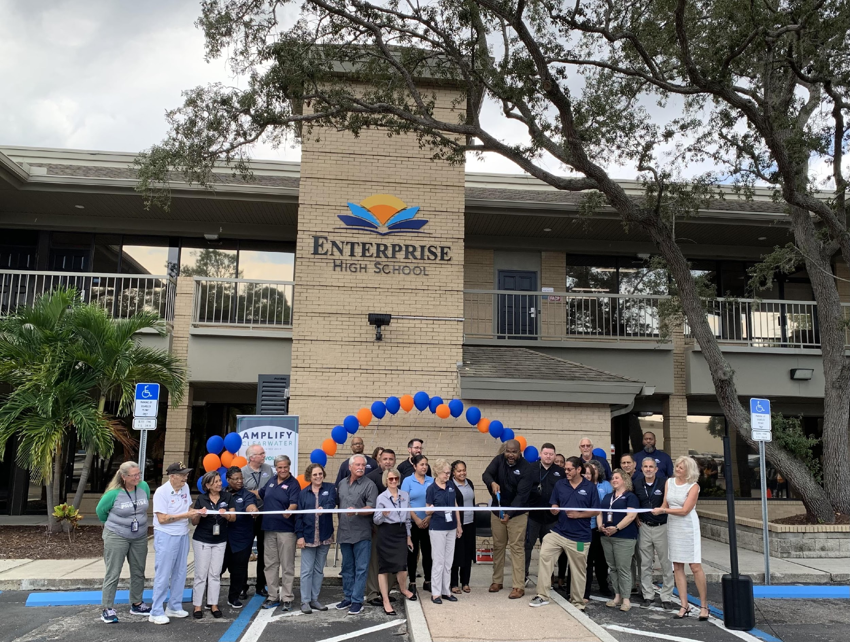
Additional Resources
Learning at Home Family Resources - https://www.pcsb.org/Page/32836
Volunteer in a Pinellas County School - https://www.pcsb.org/Page/459
Parent Academy POWER HOURS Webinars - https://www.pcsb.org/Page/26534
Partnerships - https://www.pcsb.org/Page/418

Slide 24
Contact Us
Enterprise High School
2495 Enterprise Rd.
Clearwater, FL 33763
(727) 474-1237
We appreciate your time!
Please feel free to ask any questions and provide feedback on our Title I Program.

Slide 25
Education is for improving the lives of others and for leaving your community and world better than you found it.
Marian Wright Edelman

